Slide 1


SMART INDIA HACKATHON 2025
TITLE PAGE
Problem Statement ID – SIH25126
Problem Statement Title- Student Innovation
Theme - FoodTech
PS Category- Software
Team ID-
Team Name -

Slide 2
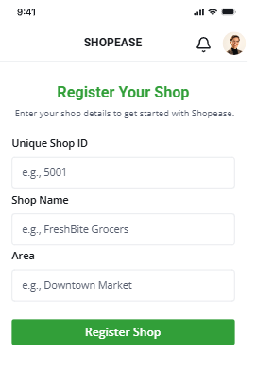
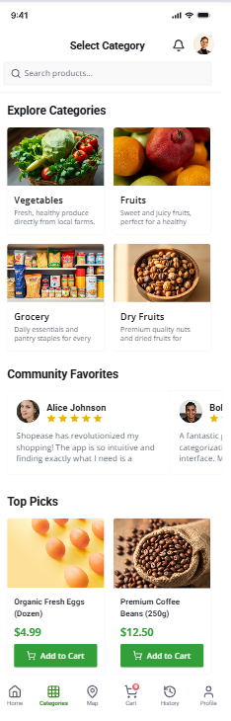
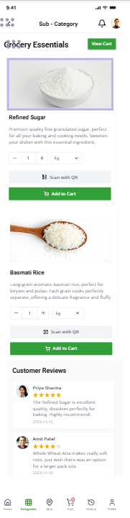
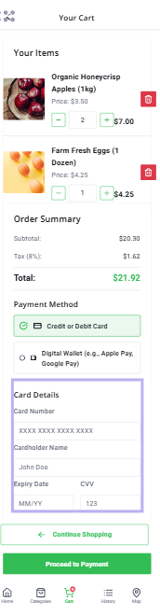
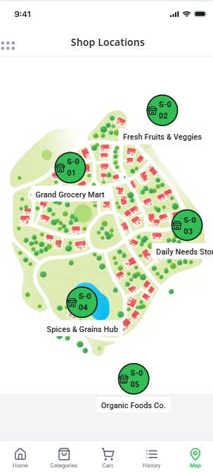
IDEA TITLE
ShopEase
REGISTRATION
SELECT CATEGORIES
SUB-CATERORY(Qty,Wt,QR,Add to cart)
PAYMENT(upi,paytm,razorpay )
Map (to show navigation

Slide 3




TECHNICAL APPROACH
ShopEase
Mobile App (Flutter):
  Customer interface for shop selection, product scanning/manual entry, cart, payment, and history.
Web Dashboard (React/Next.js):
  Shopkeeper/admin interface for inventory, QR code management, and sales analytics.
Backend (Node.js + Express):
  Handles authentication, product data, cart management, payment API integration, and analytics.
Database (MongoDB/Firebase):
  Stores product details, shop IDs, purchase history, user profiles, and analytics data.
React
Frontend (App) | Flutter
Frontend (Web) | React
Backend | Node.js
Database | Firebase / MangoDB / PostgreSQL
QR Scanning | ML Kit / ZXing
Payment Gateway | Razorpay / Paytm / Google Pay API
Map Navigation | Google Maps API
Firebase

Slide 4
FEASIBILITY AND VIABILITY
ShopEase
Analysis of the Feasibility of the Idea
1) Works with any offline retail store (small kirana to big supermarkets).
2) Requires only QR codes, smartphones, and internet which are widely available.
3) Easy integration with existing digital payment systems (UPI, Paytm, Razorpay).
4) Scalable model – can start in one city (Hinjewadi, Pune) and expand.
5) Backend + Cloud (Firebase/MongoDB) ensures real-time inventory & purchase history.
Strategies for Overcoming These Challenges
1) Conduct training & awareness workshops for shopkeepers.
2) Add offline mode with auto-sync when internet is restored.
3) Keep the UI/UX simple – large icons, dropdowns, easy QR scan.
4) Ensure data encryption & secure payments with certified gateways.
6)Offer incentives (discounts, loyalty points) to encourage adoption.
Potential Challenges and Risks
1) Adoption resistance by small shopkeepers unfamiliar with digital tools.
2) Internet dependency in rural or low-network areas.
3) Older customers may face difficulty using digital checkout.
4) Data privacy/security risks in storing customer billing info.
5) Initial setup cost for shops (QR codes, training).

Slide 5
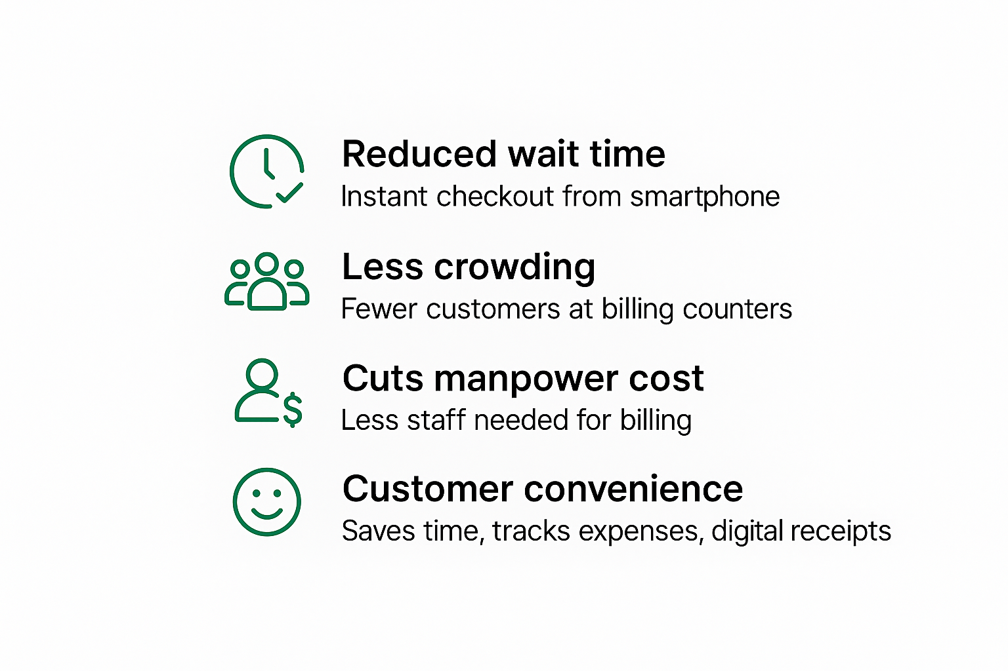
IMPACT AND BENEFITS
ShopEase
IMPACTS
Social Benefits:
  - Saves customer time & energy.
  - Improves overall shopping experience.
  - Promotes digital literacy & inclusivity.
Economic Benefits:
  - Boosts shop revenue through efficiency.
  - Reduces manpower costs at billing counters.
  - Helps small Kirana shops compete with big retail chains.
Environmental Benefits:
  - Digital receipts reduce paper usage → eco-friendly.
  - Less need for physical infrastructure at billing counters.
Scalability Benefits:
  - Start with one city expand nationwide.
  - Can be adapted to any retail domain (grocery, fashion, electronics).

Slide 6
RESEARCH AND REFERENCES
ShopEase
Details / Links of the reference and research work

